Slide 1
Yelp Restaurant Reviews Classification and Insights Generation
Data Science Intensive Capstone Project, Oct 1st 2018 Cohort
Bibek Mishra

Slide 2
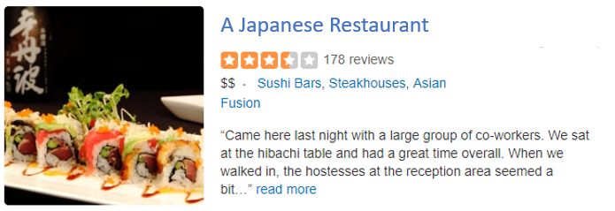


Introduction
About Yelp Dataset:
Yelp is a business directory service
and crowd-sourced review forum.
The Yelp dataset on Kaggle:
Businesses, Reviews and Users
Goal of the Project
Build a classifier that accurately classifies reviews with positive and negative sentiments
Support restaurants thrive in their businesses by
Understanding customer expectations
Gaining actionable insights from its Customer Reviews
Insights Generation from Unstructured Customer Reviews

Slide 3
Analysis of the customer reviews
Is there value in analysis of customer reviews
Crowd-sourced Reviews from actual customers. Less expensive for the restaurants to collect these reviews.
Customer Reviews are based on customers’ own experience with the restaurant staff, the food or the place.
Why Analysis of Customer Reviews is challenging ?
Many reviews. Difficult to analyze manually.
Ratings don’t tell much. Real insights lie in text reviews.
Difficult to make sense from free-form text reviews
Humans are subjective. The ratings and reviews do not always align.

Slide 4
Objective
Project tries to answer the following questions
Can we classify the restaurant reviews based on the underlying positive or negative sentiments ?
Build a classifier
What do the positive and negative reviews predominantly mention ?
Top Words from Positive and Negative reviews
Can a restaurant analyze its positive and negative reviews and get actionable insights ?
Topics generation
The answer to all 3 questions is Yes !!

Slide 5





Who might care?
The insights in the project can be valuable to any business with following goals
Improve customer experience/interaction based on their reviews
Understand important phrases and key topics from the customers’ text reviews.
Classify whether a text review has positive or negative sentiment.
Crowd-sourced Review Apps
Restaurants
Hotels &Travel

Slide 6
What Data do we have ?
Yelp Datasets
Business: Business ID, Category
Reviews: Customer Reviews (text) with ratings (1-5)

Slide 7
Part I: Build a Classifier on All restaurant Reviews
Part II: Insights Generation from reviews of one restaurant

Slide 8
Part I: Build a Classifier on All restaurant Reviews
Part II: Insights Generation from reviews of one restaurant

Slide 9
Exploratory Data Analysis Data Wrangling
Business Dataset
Reviews Dataset

Slide 10
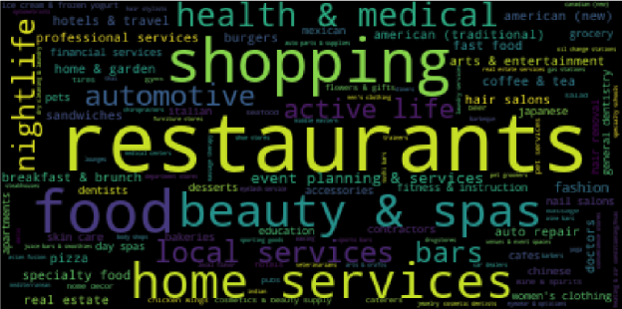
Business Dataset
What is a Restaurant [Wikipedia]
A restaurant or an eatery is a business which prepares and serves food and drinks to customers for money. Meals are generally served and eaten on the premises, but many restaurants also offer take-out and food delivery services.
What categories to choose ?
Categories
Restaurants ?
Any other categories ?
Guiding Principles
Serve food/drinks to customers for money
Served and eaten on premise

Slide 11
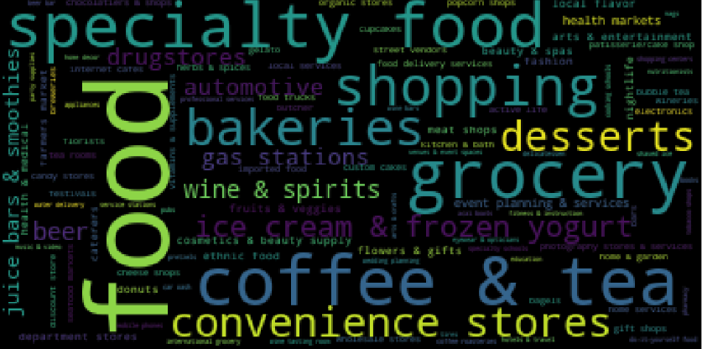
Business Dataset
What qualifies as a restaurant ?
Categories of establishments that are not a Restaurant technically, but serve Food.
Guiding Principles
Serve food/drinks to customers for money
Served and eaten on premise
Chosen Categories for Insights
Restaurants
Bakeries
Juice Bars

Slide 12
Reviews Dataset
Fields of Interest
Stars: 1 – 5
Text: The actual text review
Stars | Ratings of Review
1,2 | Negative
3 | Neutral
4,5 | Positive
We only consider the reviews with ratings [1,2] and [4,5] in scope of project. The reviews with rating 3 are not in scope of the project.

Slide 13
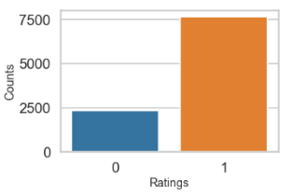
Reviews Dataset
Fields of Interest
Training Dataset: 10,000 reviews
Test Dataset: 3000 reviews
Insights
Reviews: 76% Positive, 24% Negative
Imbalanced Class
Will Implement up-sampling technique SMOTE in modeling phase

Slide 14
Steps in Text Data Processing
Tokenization: Parse the texts to collect the words (e.g. tokens)
Filtering: Stop-Words Removal, Frequent Words Removal (based on context)
Stemming or Lemmatization: Converts words to their roots (stems or lemmas)
Lemmatization better for legibility: Lemmas are full words
Example: Running -> Runn (stem), Run(Lemma)
Vectorization: Convert words/tokens to Aggregated Vectors
Example:
Count Vectorizer captures the count of each token in a document in vector form.
The TF-IDF Vectorizer looks at term frequency as well as document frequency. Unique words in documents are weighed high and common words across documents are weighted low. Improved representation of term importance in the context of a document.

Slide 15
Steps in Modeling
Example: Classifier using Count Vectorizer (Vectorizer) and Naïve Bayes (Classifier)
Steps
The text restaurant reviews input into a vectorizer to form feature vectors.
The imbalanced class in Feature vectors were up-sampled using SMOTE.
Feature vectors were fit using the classifier.
Hyper-parameters related to the Vectorizer and Classifer were tuned through CVGridSearch based on best accuracy.
Model was built using the best hyper-parameters on the complete training dataset.
The performance of the best model on the test dataset (unseen data) was found out.

Slide 16
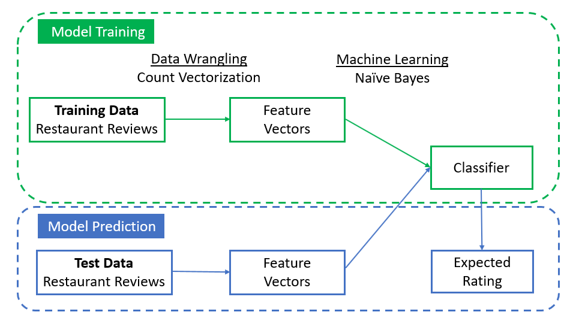
Base Model
Vectorizer: Count Vectorizer, Classifier: Naïve Bayes
Block Diagram (Model Training + Model Prediction)

Slide 17
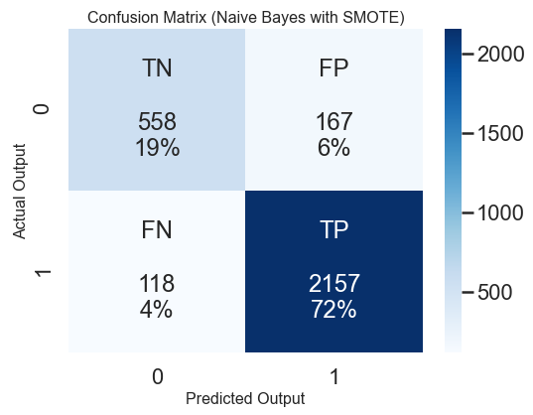
Base Model: Results Analysis
Model Performance
Model | Best Hyperparameters | CV Accuracy (Training Set) | Accuracy (Test Set) | Recall Score (Test Set) | F1 Score (Test Set)
Count Vectorizer (CV) + Naïve Bayes (NB) | CV(min_df: 0.0001) NB(Alpha: 1) | 91.98% | 90.5% | 94.8% | 93.8%
Confusion Matrix
Insights
The model generalized well (comparable performance on training and test set).
Confusion Matrix: High number of negative reviews (167) classified as positive reviews. 118 positive reviews classified as negative

Slide 18
Base Model: Top Words Analysis
Words with Positive Sentiment
Words | % +ve
gem heaven donut feta delish | 98
phenomenal refreshing art disappoint pleasure pleasantly | 97
Insights from Positive Reviews
Most words make sense (e.g. gem, heaven, refreshing, pleasantly etc.)
Some words are questionable (e.g. donut, art, disappointing) => Contexts missing. N-gram analysis required
Words with Negative Sentiment
Words | % +ve
unprofessional | 02
downhill tasteless | 03
horrible filthy | 04
worse unfriendly rudely awful miserable worst disgusting Refund | 05
Insights from Positive Reviews
Most words associated with negative connotation (e.g. unprofessional, horrible, disgusting)
Context Missing. Horrible What ? Horrible Food or Horrible Service. N-gram analysis will help.

Slide 19
Why Language Contexts are necessary ?
Mispredicted Review (Actually Positive, Predicted as Negative)
Really good food, but beware the portions are huge!!! Was full off of the truffle fries alone with brisket and French dip to follow, didn't even finish half of the later 2 and ended up having to throw away leftovers due to hotel not having a refrigerator...only complaint was the long wait almost an hour just to find out they hadn't put our name down on the list or failed to call us when we were waiting right outside the entrance, luckily they got us a table immediately upon discovering the error.
Language Constructs
Important to understand the context of language.
Suggested Methods
Stop-words Removal
Lemmatization with POS and Verbs consideration
N-grams Analysis

Slide 20
Why Language Contexts are necessary ?
Review Example
Went in for a lunch. Steak sandwich was delicious, and the Caesar salad had an absolutely delicious dressing, with a perfect amount of dressing, and distributed perfectly across each leaf. I know I'm going on about the salad ... But it was perfect.\n\nDrink prices were pretty good.\n\nThe Server, Dawn, was friendly and accommodating. Very happy with her.\n\nIn summation, a great pub experience. Would go again!
Review after Stop-words Removal and Lemmatization
go lunch steak sandwich delicious caesar salad absolutely delicious dress perfect amount dress distribute perfectly across leaf know go salad perfect drink price pretty good server dawn friendly accommodate happy summation great pub experience would go
The subsequent models will use the lemmatized reviews as input.

Slide 21
Other Models
TF-IDF Vectorizer (with Trigrams) + Naïve Bayes
TF-IDF Vectorizer presents better representation of terms importance.
Naïve Bayes is computationally fast and works well with high dimensional data.
Naïve Bayes does not consider dependency between features which is pretty common in free-form text.
TF-IDF Vectorizer + Logistic Regression
Logistic Regression is good at representing the relationship between input and output.
Models using Logistic Regression easily overfit
TF-IDF Vectorizer + Random Forest
Random forest is an ensemble of many decision trees that works well on correlated data.
Easy to find feature importance and model explainability.

Slide 22
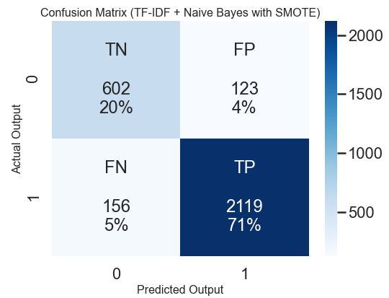
All Models: Results Analysis
Model Performance
Model | Best Hyperparameters | CV Accuracy (Training Set) | Accuracy (Test Set) | Recall Score (Test Set) | F1 Score (Test Set)
CV + NB (Base) | min_df: 0.0001, Alpha: 1 | 91.98% | 90.5% | 94.8% | 93.8%
TF-IDF + Naïve Bayes | min_df: 0.001, Alpha: 0.1 | 91.1% | 90.7% | 93.1% | 93.8%
TF-IDF + Log Reg | C = 10 | 93.15% | 92.2% | 94.7% | 94.8%
TF-IDF + RF | max_depth: 10, n_estimators: 100 | 83.725% | 84% | 92.7% | 89.8%
Insights
The performance of Naïve Bayes and Logistics Regression classifiers were comparable.
TF-IDF with Logistics Regression performed best on the basis of classification accuracy.
TF-IDF + Naïve Bayes : CF

Slide 23
Comparison: Top Words Analysis
Count Vectorizer + Naïve Bayes
TF-IDF (ngram) + Naïve Bayes
Words with Positive Sentiment
Words | % +ve
gem heaven donut feta delish | 98
phenomenal refreshing art disappoint pleasure pleasantly | 97
Comparison
The top words from TF_IDF (ngrams) vectorizer are more informative and and contain contexts language specific contexts.
The top words from TF_IDF (ngrams) portray that people writing positive reviews typically mention about friendly staff or/and great food. Such analysis is not feasible from unigrams.
Words with Positive Sentiment
Words | % +ve
great food | 99
hit spot | 99
staff super | 99
heaven | 99
great service | 99

Slide 24
Comparison: Top Words Analysis
Count Vectorizer + Naïve Bayes
TF-IDF (ngram) + Naïve Bayes
Words with Negative Sentiment
Words | % +ve
unprofessional | 2
downhill tasteless | 3
horrible filthy | 4
worse unfriendly rudely awful miserable worst disgusting Refund | 5
Comparison
The top words from TF_IDF (ngrams) vectorizer are more informative and contain contexts language specific contexts.
Ngram analysis reveals that people writing negative reviews mostly write about horrible service and avoiding the place.
Words with Negative Sentiment
Words | % +ve
avoid place | 0
horrible service | 0
worst service | 1
roach | 1
service awful | 1

Slide 25
Part I: Build a Classifier on All restaurant Reviews
Part II: Insights Generation from reviews of one restaurant

Slide 26
Business Dataset
One restaurant selected for Insights Discovery
Criteria:
Categories: Restaurant, Seafood
Random selection of an restaurant from restaurants with more than 1000 reviews
Business of Interest: Business ID => yNPh5SO-7wr8HPpVCDPbXQ

Slide 27
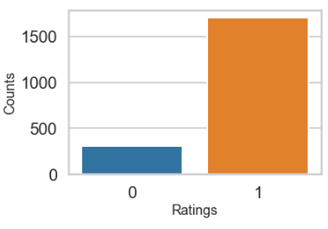
Reviews Dataset
Fields of Interest
Training Dataset: 10,000 reviews
Test Dataset: 3000 reviews
Insights
Reviews: 85% Positive, 15% Negative
Imbalanced Class not an issue for Topic Recognition because we will find out the topics form Positive Reviews and Negative Reviews separately.

Slide 28
Topics Modeling
Topics Modeling is an unsupervised learning approach used for clustering documents and discovering topics based on their contents.
LDA (Latent Dirichlet Allocation)
Probabilistic Model
Used predominantly with TF Vectorizer as the algorithm inherently decides term importance.
NMF (Non – Negative Matrix Factorization)
Linear Algebraic Model
Converts high dimensional vectors into low-dimensional representations.
I used TF-IDF Vectorizer with NMF.

Slide 29
Topics Modeling
Steps
Text Pre-processing
Converted reviews text to lemmatized text using stopwords removal and lemmatization with POS
Vectorization
Choose best hyperparameters for Vectorizers (min_df, max_df, no_features). I chose 1000 features as maximum limit for the project.
The lemmatized reviews associated with positive ratings were input to Vectorizer in order to create the feature vectors.
Topics Modeling
The feature vectors were input to NMF and LDA models separately for topics recognition.
I chose to display top 2 topics, 4 words per topic and 2 top reviews per topic.
Display of Topics and Top Documents in the topics
Finally, the topics and the top reviews were displayed.

Slide 30
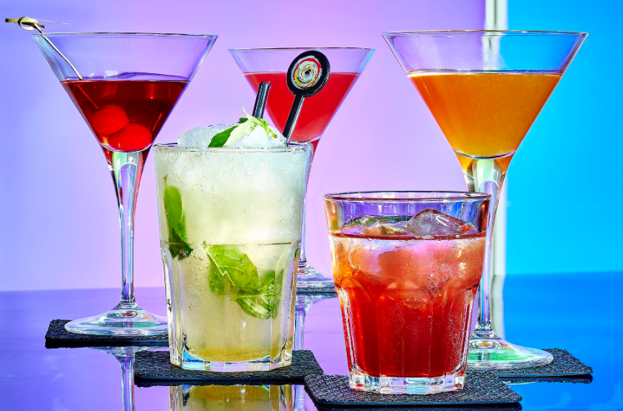
Insights from Positive Reviews
Insights
Good food and Service
Great Cocktail
Good Place for food
Generated Topics
good order come like (NMF, Topic 1)
great food service place (NMF, Topic 2)
great cocktail orange make (LDA, Topic 1)
great good food place (LDA, Topic 2)
Top Reviews associated with these topics
Review 1
We have heard a lot about this place and were finally able to go.. Service was friendly and fast and food was good. We got the jambolaya and the fish and chips which were both really good. The best part of our meal was the dessert.. We got the salted carmel pudding and it was sooo good! We would go back just for that dessert! Everything tasted nice and fresh it was excellent. (NMF, Topic 1)
Review 2
Ask for Chip ... it's really like going to Disneyland, except it's restaurant. Great, knowledgable service, good food ... fun times (LDA, Topic 2)

Slide 31

Insights from Negative Reviews
Insights
Good food and Service, but long wait times
Slow Service
Expectation of free goodies in case of a bad experience
Generated Topics
food good place like (NMF, Topic 1)
Wait minutes table seat (NMF, Topic 2)
food good time service (LDA, Topic 1)
food good order place (LDA, Topic 2)
Top Reviews associated with these topics
Review 1
We visited this past weekend. It took on hour to receive our meal and two of the dishes were cold. The waiter was bad but gave us free dessert to make up for the food and service. The peanut butter cup gelato was inedible. Tiny scoop of gelato with peanut butter slop on top. Not sure if the restaurant just had a staffing issue or what but we'd never go back. (NMF, Topic 2)
Review 2
We came in this weekend and at the bar For 20min. No one Even made eye contact with us. But I gave
Them the benefit, there were 4 of us so we were visible. We went upstairs to tilted kilt. (LDA, Topic 1 Part of Review)

Slide 32
Recommendations for the Restaurant Establishment
Recommendations from the Positive Reviews (Keep Doing the Following)
Most customers find the food and service at the restaurant good.
The restaurant should continuously thrive to maintain this high quality of food and service.
The cocktails are a hit !! The restaurant should continue to serve great cocktails in order to gain the goodwill of the customers.
Recommendations from the Negative Reviews (Follow Corrective Actions)
People typically like the food and the place but have complained about the (1) long wait times at tables and (2) slow service.
Management should mitigate the long wait time and slow service after finding the root cause of the problem. Few recommendations based on few common root causes are mentioned below
Short-staffing => Hire more staff
Menu has most items that require fresh preparation => Hire more cooks OR Introduce more items in menu that can be semi-cooked and put in refrigerator/storage. Fully Cook when customer places orders
Work Culture Issue: Train the staff on customer responsiveness.

Slide 33
Conclusion and Future Work
Conclusion
Analysis and modeling of restaurant reviews can uncover many insights on customer feedback
First, I built a text classifier to accurately classify the positive/negative sentiment associated with restaurant reviews.
The classifier based on TF-IDF and Logistic Regression had the best performance (92.2% accuracy)
I modelled topics from positive and negative reviews of a restaurant, interpreted them and provided specific recommendations.
Future Work
I plan to implement the project using deep learning in the future so that considerably higher number of reviews can be considered for insights generation.
Working with high magnitude of text reviews may help determine the best classifier for the problem.

Slide 34
Reference & Disclaimer
Reference
I am thankful to my Data Science mentor Dr Alex Aklson and the Springboard community for their continuous support and encouragement during all phases of the project.
I thank all the writers of NLP related articles on datacamp and medium, that served as relevant references on the subject.
Disclaimer
All product names, logos, and brands are property of their respective owners. All company, product and service names used in this website are for identification purposes only. Use of these names, logos, and brands does not imply endorsement.

Slide 35
Thank You
Bibek Mishra
Email: bibekmishra@aggienetwork.com
Github: www.github.com/bibekm

